Slide 1
Lifelines in the Classroom
Presented by:
Fort Bend Independent School District
Special Education Department
January 20, 2022
Adapted from
Region 4 Education Service Center

Slide 2
Learning Intentions
Understand the roles and responsibilities of a paraeducator.
Understand how a paraeducator can support the instruction process.
Gain knowledge and resources for documentation/data collection.

Slide 3
Success Criteria
I will have a better understanding of the paraeducator’s roles and responsibilities in the classroom.
I will have a better understanding of how paraeducators support the instruction process.
I will have a better understanding of the resources used for data collection.

Slide 4
Defining the Role of the Paraeducator
Learning Objectives:
Recognize that a paraeducator’s actions are under the direction and supervision of the partner teacher.
Discuss the distinctions between roles and responsibilities of paraeducators and partner teachers and how they will vary across settings.

Slide 5
The Roles and Responsibilities of Paraeducators
While specific descriptions of responsibilities are left up to individual states and local education agencies, the following provides guidance for determining roles and responsibilities in the following areas:
Setting/Organization
Support Assessment
Goals and Objectives
Instruction
Positive Behavior Supports

Slide 6
Teacher Takes responsibility for instruction of new concepts, skills, and each new classroom activity. Revises instructional programs. Designs and adapts instructional materials. Designs and implements behavioral intervention plans. Communicates with parents. Responsibility for behavioral management. Attends in-service workshops Directs and assists with activities meeting the physical needs of students such as feeding, toileting, dressing and catheterization. Develops and implements integration activities and strategies. Assists in planning and implementation of transition services. Coordinates and participates in team meetings and parent meetings. Supervises paraprofessionals and volunteers in accordance with district policies. | Paraprofessional Reinforces and review concepts and skills. Assists students in performing activities initiated by the supervising teacher. Monitors student progress in instructional programs and relates findings to supervising teacher. Helps develop instructional materials designed by the supervising teacher. Monitors and reinforces student performance concerning behavioral interventions through observation, assumes data collecting, compilation, and record keeping duties. Assists in maintaining records associated with the parent conferencing procedure, confirms conference dates, etc… Attends in-service activities Demonstrates knowledge of curriculum content for classes which he/she assists. Assists with the physical needs of students—feeding, toileting, dressing, and catheterization.

Slide 7
Assessments
Teacher’s Role
Assesses students.
Administers tests.
Assigns grades.
Interprets assessments
Paraeducator’s Role
Monitoring objective test items.
Report results and observations to teacher.
Provide oral administration if needed per ARD paperwork.

Slide 8
IEP Goals & Objectives
Teacher’s Role
Determines appropriate objectives with input from the ARD team.
Paraeducator’s Role
Should have input to goals and objectives, especially by providing daily updates on student progress, accommodation logs, sharing work samples, and data.
Implements lessons to meet goals and objectives.

Slide 9
Instruction
Teacher’s Role
Provides instruction to the entire group, small groups and individuals.
Paraeducator’s Role
Provides follow-up instruction to small groups and individuals.
Reinforces the teaching of the teacher by following lessons and providing accommodations and support.

Slide 10
Positive Behavior Supports
Teacher’s Role
Plans positive behavioral supports for groups and individuals.
Paraeducator’s Role
Implements positive behavioral strategies using the same techniques as the teacher, based on ARD paperwork.
Helps to determine appropriate strategies based on daily contact with students.

Slide 11
The following are activities that a paraeducator should NOT do:
Assign final grades.
Score or interpret assessments that require subjective judgment.
Assume final responsibility for students for an indefinite amount of time.
Have primary responsibility for writing an Individualized Education Program (IEP).
Make a decision about a student’s educational program without teacher approval.
Teach to the class without the teacher present.
Make modifications or adaptations without training and the teacher’s approval.
Inappropriate Activities

Slide 12
Learning Objectives:
Recognize that a paraeducator’s actions are under the direction and supervision of the partner teacher.
Identify instructional concepts (cues/prompts, modeling, shaping, wait time, reinforcers, and fading) that paraeducators may use in the classroom.
Identify instructional strategies to help teach independence.
Supporting the Instructional Process

Slide 13
Factors that Promote Learning
Using effective classroom management.
Using direct systematic teaching.
Focusing on time for learning.
Providing opportunities for success.
Establishing goals and expectations.
Monitoring progress and giving feedback.
Providing positive and supportive
learning environments.
Teaching students to generalize
learning.

Slide 14
Learning the Lingo
Cues/Prompts
verbal or nonverbal signals that indicate what action is necessary.
Wait Time
the amount of time given to the student to respond to a question or complete a task.
Reinforcer
-reinforcers that occur naturally to increase the likelihood that a behavior will reoccur, or
-reinforcers that are contrived (not naturally occurring) and are intentionally provided to increase the behavior or to ensure task completion.
Fading
a gradual reduction of cues/prompts and extrinsic reinforcers as the student demonstrates desired behavior or task.

Slide 15
Cycle of Support
The teacher develops the plan.
The paraeducator gives the teacher feedback about student performance.
The teacher models the instructional strategy for a paraeducator.
Cycle of Support
The teacher gives the paraeducator feedback.
The teacher assigns a paraeducator a role in instruction.

Slide 16
General Strategies in the Classroom
Focus on student strengths-”You are good at…..” “I like the way you…”
Use Movement-don’t stay hovering over students receiving special education services
Keep expectations high
Break tasks into smaller steps-fold page in half, use a file folder cut with flaps
Extended time on tasks- be sure to note it at the top of the assignment (15 minutes extended time)
Present limited amount of info on a page
Offer support, do not just give it-don’t automatically do it for them
Make things concrete- use manipulatives, pictures, graphic organizers, etc.

Slide 17
Learning Objectives:
Gain additional knowledge with documentation in regards to a paraeducator’s role.
Understand the purpose of adequate and effective documentation.
Receive various data collection tools for use.
Documentation/Data Collection

Slide 18
Purpose of Data Collection & Documentation
Verify Services
Establish Baseline Data
Present Levels of Performance
Progress Monitoring
Patterns
Allocate resources
Student involvement
Decision making

Slide 19
Collect accurate and reliable data
Be consistent
Stick to your definition of the target skill/behavior
Stick to your criteria for acceptable performance
Implement Data Collection Method

Slide 20
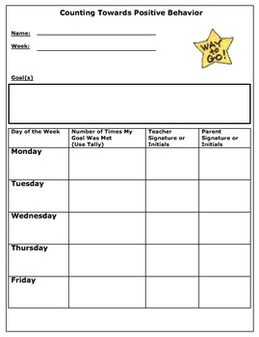
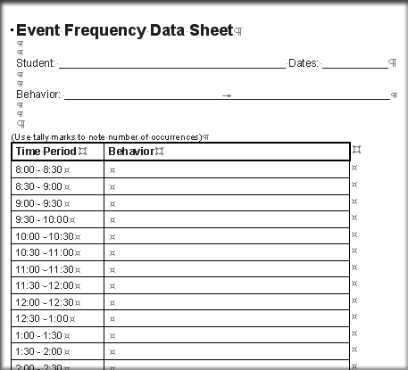
Behavior Data Collection…

Slide 21
Inclusion Log
Special Education Teachers and/or Paraprofessionals providing in class or co-teach support will complete the log.
Support will be documented on the day it was given to the students receiving special education services.
Logs are located in one binder in the classroom and easy to find.
Logs should be turned in each nine weeks to the Special Education Department Head.

Slide 22
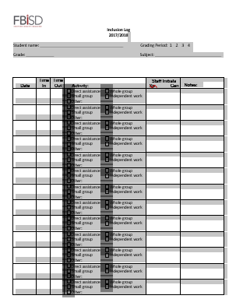
Logs, Logs, Oh My!

Slide 23
Accommodation Log
General Education and/or Special Education Teachers will complete the log.
This log is a way to track accommodations provided for students in the general education classroom.
At the end of each nine-week grading period, accommodation Logs should be uploaded into the FBISD student information management system, SuccessEd.

Slide 24
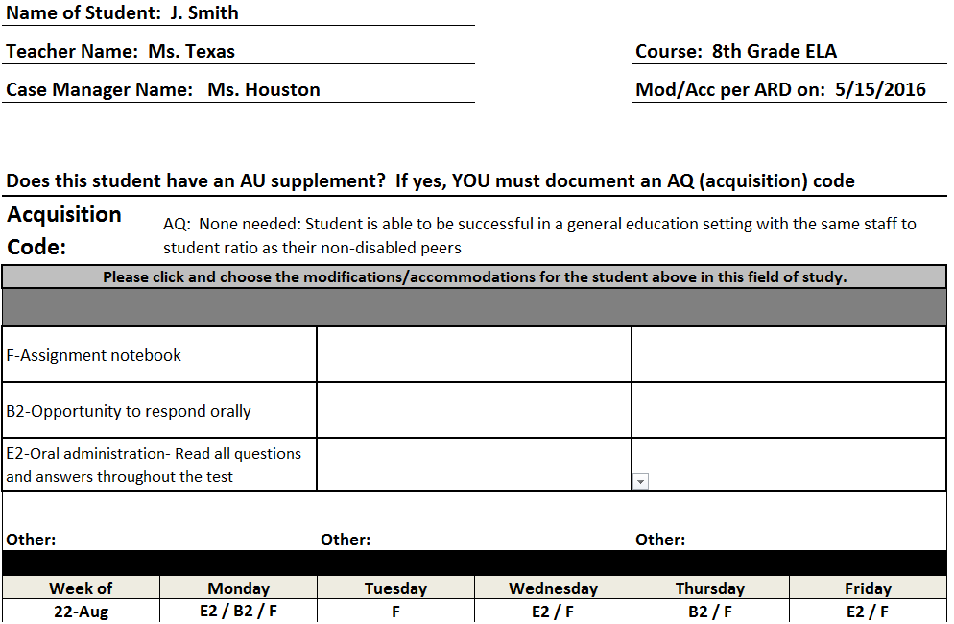

Slide 25
FBISD Special Education Department
Dr. Deena Hill, Executive Director of Special Education
Sheralea Maston, Director
Reba Brown, Assistant Director
Program Managers
Amy Carney, Yuvonne Fields and Christopher Bowie
Program Specialists
Elementary: Dawn Clem, Courtney Hardy, Dawni Kitchen, Michelle Miller
Middle School: Joyce Arthur, Shavonta Crawford
High School: Brian Tolston, Paul Wilburn

